Slide 1




NEXT GEN EMPLOYABILITY PROGRAM
Creating a future-ready workforce
Team Members
College Name
Student Name : Prithiviraj A
Student ID : au311121104045
Loyola-ICAM College of Engineering and Technology

Slide 2

CAPSTONE PROJECT SHOWCASE
Project Title
Music Web Application using Django Framework
Abstract | Problem Statement | Project Overview | Proposed Solution | Technology Used | Modelling & Results | Conclusion

Slide 3
Abstract
The music web application is a platform built using the Django Framework, designed to provide users with a seamless music streaming experience. Users can browse a vast library of songs, albums, and artists, create playlists, and discover new music based on their preferences. The application offers a user-friendly interface, responsive design, and efficient search functionality, making it easy for users to find and enjoy their favorite music. With features such as personalized recommendations and social sharing, the music web application aims to enhance the way users discover and engage with music online
Source :

Slide 4
Problem Statement
In a crowded digital music landscape, users struggle to find personalized music streaming platforms with user-friendly interfaces. This project aims to develop a Django-based music web application that offers a seamless experience, including a vast music library, personalized playlists, and smart recommendations. By filling this gap, the application seeks to enhance how users discover and enjoy music online.
Source :

Slide 5
Project Overview
Title: Harmonix
Objective: Develop a Django-based music web application to provide users with a seamless music streaming experience, including personalized playlists and smart music recommendations.
Key Features:
Vast music library: Provide access to a wide range of songs, albums, and artists.
Personalized playlists: Allow users to create and manage playlists based on their preferences.
User-friendly interface: Design an intuitive and responsive interface for easy navigation.
Social sharing: Enable users to share their favorite music with friends on social media platforms.
Target Audience: Music enthusiasts looking for a personalized and user-friendly music streaming platform.
Outcome: The project aims to revolutionize how users discover and enjoy music online by offering a seamless and personalized music streaming experience.
Source :

Slide 6
Proposed Solution
Title:Harmonix
Description: Harmonix is a cutting-edge music web application built using the Django Framework, offering a next-level music streaming experience. The application boasts a vast library of songs, albums, and artists, enhanced by features such as personalized playlists, smart music recommendations, and a visually stunning user interface.
Key Features:
Dynamic Music Library: Harmonix’s music library is continuously updated with the latest songs, albums, and artists from around the world.
Source :

Slide 7
Personalized Playlists: Users can create, customize, and share playlists based on their unique preferences and moods.
Intelligent Music Discovery: Harmonix utilizes machine learning algorithms to analyze user listening habits and provide tailored music recommendations.
Engaging User Interface: The application features a modern and responsive design, with interactive elements that enhance the user experience.
Social Integration: Users can connect with friends, share favorite tracks, and discover new music together through social media integration.
Source :

Slide 8
Technical Stack:
Frontend: HTML, CSS, JavaScript, React.js
Backend: Django Framework, Django REST framework
Database: PostgreSQL
Hosting: AWS EC2, S3 for media storage
Machine Learning: Python, TensorFlow for recommendation engine
Target Audience: MeloTune targets music enthusiasts who seek a sophisticated and personalized music streaming platform that goes beyond conventional offerings.
Outcome: MeloTune aims to set a new standard in music streaming by combining cutting-edge technology with a user-centric approach, providing a unique and immersive music experience for all users.
Source :

Slide 9


Technology Used
Front-end
Back-end
Source :

Slide 10
Modelling & Results
Modeling:
Data Model: Utilize Django's ORM to define models for songs, albums, artists, playlists, and user interactions (e.g., likes, shares).
Machine Learning Model: Use TensorFlow or scikit-learn to develop a recommendation engine based on user listening history and preferences.
Results:
Dynamic Music Library: Users will have access to a diverse and continuously updated music library, ensuring a wide selection of songs, albums, and artists.
Personalized Playlists: The recommendation engine will enhance user experience by suggesting songs and artists based on their listening habits, leading to more personalized playlists.
Engaging User Interface: The modern and responsive design will provide a visually appealing and intuitive user interface, enhancing user engagement and satisfaction.
Social Integration: Users will be able to connect with friends, share favorite tracks, and discover new music together, fostering a sense of community within the application.
Source :

Slide 11
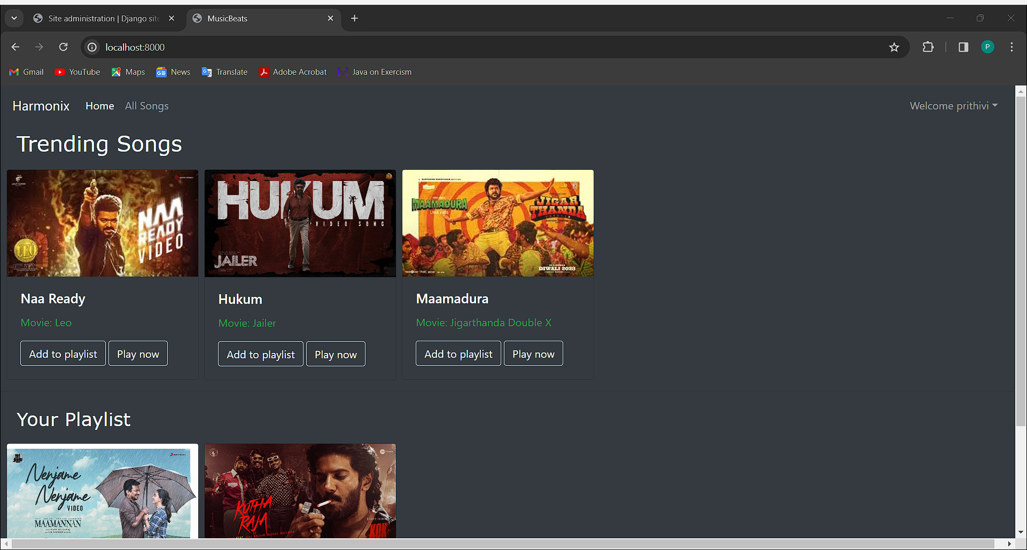
Homepage

Slide 12
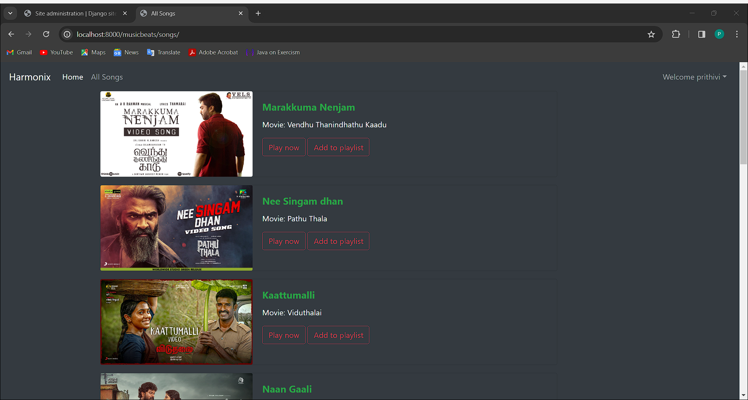
All Songs

Slide 13
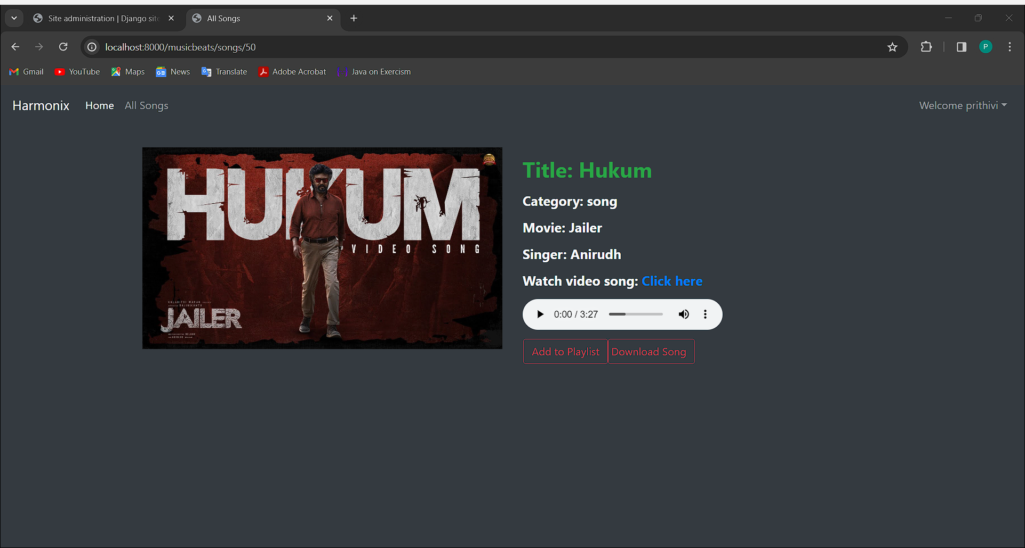
Song

Slide 14
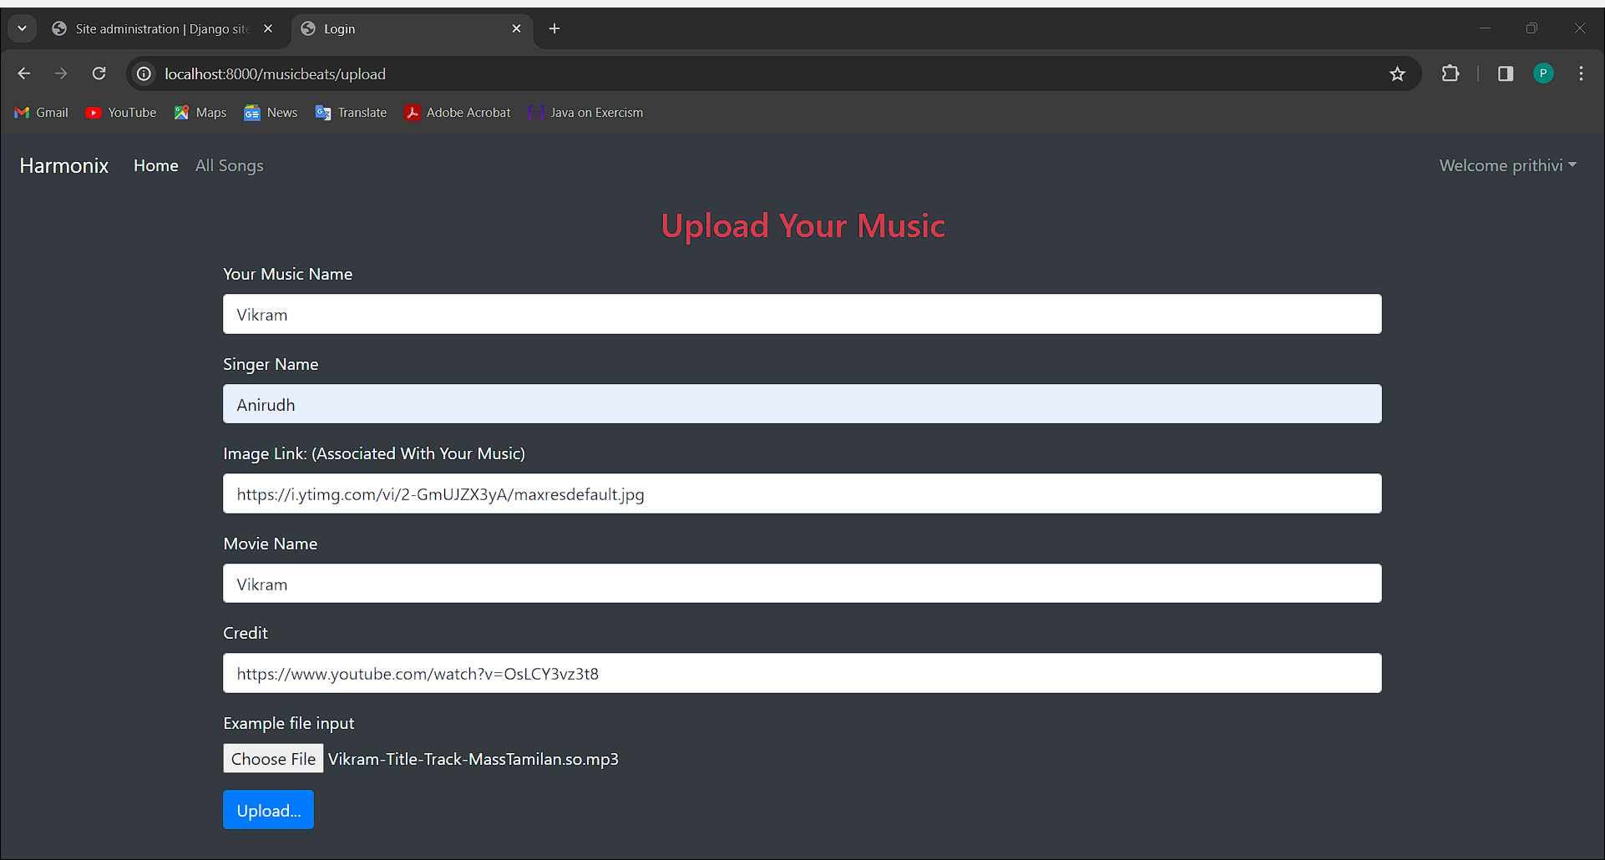
Upload Music

Slide 15
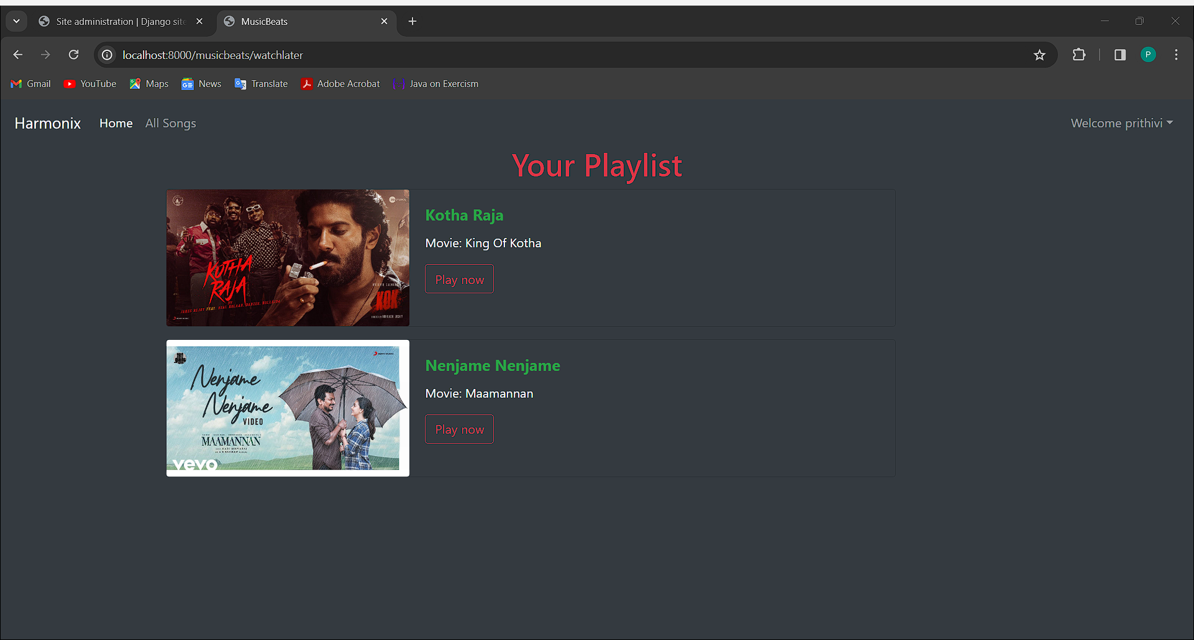
Your Playlist

Slide 16
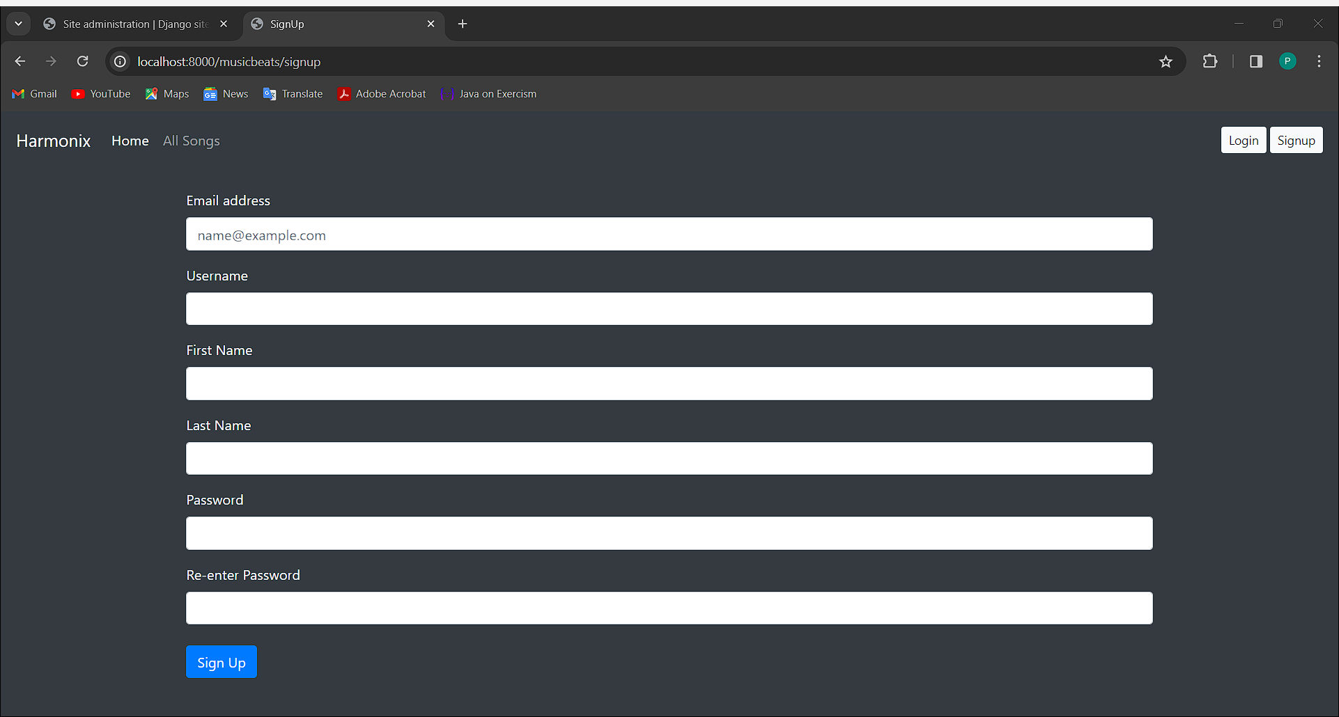
Signup

Slide 17
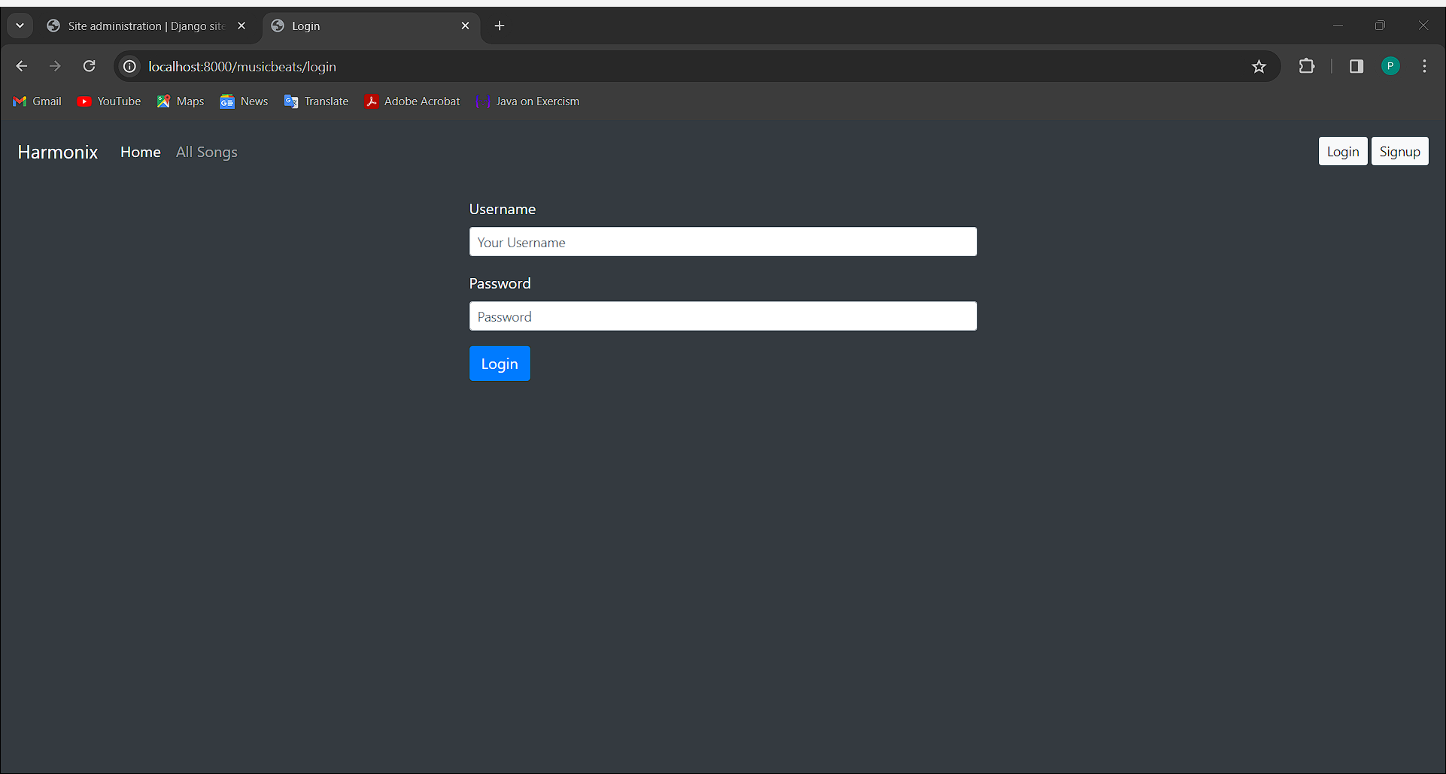
Login

Slide 18
Future Enhancements:
Advanced Recommendation System: Implement more advanced machine learning algorithms to improve the accuracy of music recommendations based on user preferences, listening history, and behavior.
Social Features: Expand social integration by allowing users to follow each other, create public playlists, and see what their friends are listening to in real-time.
Lyrics Integration: Add a feature to display lyrics for songs, enhancing the overall music listening experience.
Artist and Album Insights: Provide users with more information about artists and albums, such as biographies, discographies, and related content.
Podcast and Audiobook Support: Extend the platform to include podcasts and audiobooks, offering users a wider range of audio content.
Music Discovery Tools: Develop tools for users to discover new music based on genres, moods, or themes, helping them explore a broader range of music.
Integration with Smart Devices: Allow users to access MeloTune on smart speakers, TVs, and other connected devices for a seamless music listening experience across different platforms.

Slide 19
Conclusion
In conclusion, Harmonix is poised to revolutionize the music streaming experience with its sophisticated features and user-centric design. By offering a dynamic music library, personalized playlists, an engaging user interface, and social integration, Harmonix caters to the diverse needs of music enthusiasts.
The application's technical stack, including HTML, Bootstrap, Django Framework, Django REST framework, and sqlite, ensures a robust and scalable platform. Harmonix's target audience, comprising music enthusiasts seeking a personalized music streaming experience, is well served by its innovative features and user-friendly interface.
With potential future enhancements such as advanced recommendation systems, social features, and integration with smart devices, Harmonix is positioned to remain at the forefront of the music streaming industry. Overall, Harmonix is not just a music streaming platform but a destination for music lovers to discover, share, and enjoy music in a whole new way.
Source :

Slide 20
Thank You!
Notes:
Thank You !!

